Slide 1
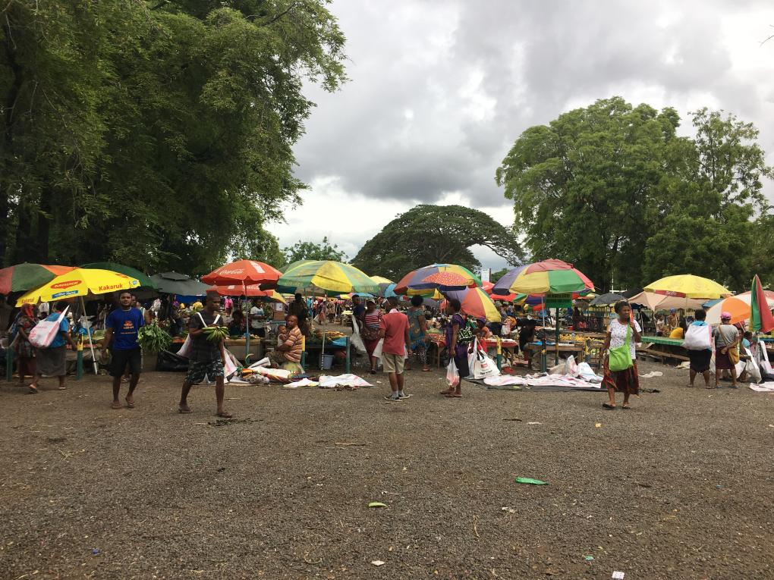

Market fee payment through custom-made software: the findings of a pilot
Nisa Fachry¹, Amanda H A Watson² and Christina Cheong¹
¹ UN Women ² Australian National University

Slide 2
THE PROJECT
MARKET FEE PAYMENT
SYSTEM
PILOT AT
BOROKO
MARKET
EVALUATION

Slide 3
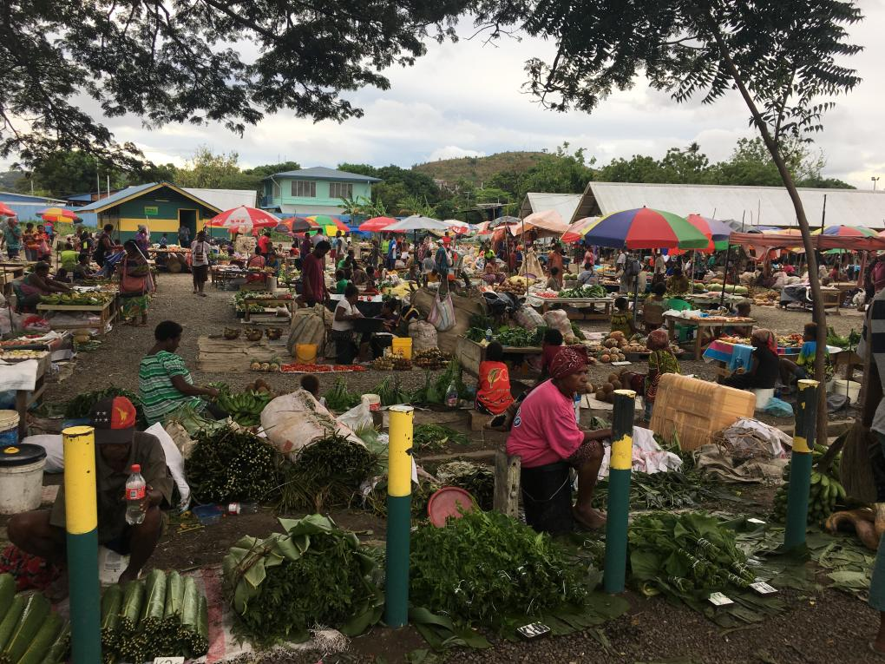
THE PROJECT

Slide 4
PORT MORESBY
SAFE CITY PROGRAMME
Programme objective: To improve safety at markets
Challenges:
Extortion and unauthorised fee collection.
Leakage in fee processing.
Inefficient accounting and reporting.
Authorities unable to manage spaces in markets.
Intervention: To explore a different fee collection system to address the challenges.
Notes:
The Port Moresby Safe City Programme is a partnership between UN Women and NCDC.
The Programme aims to improve safety in the city markets to improve the access for women and girls to economic opportunities and other services.
At most markets, vendors pay a daily fee to market clerks for the use of the space and facilities within the markets.
Some challenges with the existing system include:
Extortion for fees, perpetuated by market security personnel, market clerks, or others (usually men). Vendors (usually women) often end up paying more than the official daily fee to avoid repeated harassment by different groups for money.
The cash collected daily is not accounted daily, resulting in significant leakage due to unauthorised “loans”, etc.
The cash and paper receipt butts take a long time for clerks and office managers to count and acquit on a daily basis.
The sale of tickets at gates disconnects spaces from the fees, resulting in the inability to manage how much space each vendor occupies.
This results in strong sense of territory among vendors with the consequence that new vendors face immense barriers in finding spaces in popular markets.
Intervention: a different fee collection system to address the challenges.

Slide 5
DESIGNING THE INTERVENTION
Human-centred design approach
Fee collection system
NCDC Markets Management
NCDC Markets Clerks
Market vendors
Notes:
We employed a human-centred design approach,
which refers to a problem solving methodology that involves the people (or users) for whom the service is intended in the design process of a system.
This includes consulting users from both sides of the fee collection system – NCDC and the vendors.
Focus groups and a design workshop with NCDC Market Division to understand:
The evaluation of the paper-based ticketing system, including its benefits and problems
Co-design a new payment system which can reduce extortion and potentially improve the feeling of safety at the markets.
VENDORS: Semi-structured interview and focus groups with the market vendors with the focus on understanding:
Their feedback on the paper-based collection system. Topics asked were as follows: the fee collection process, the fare, their capability in paying for the fees, their willingness to pay in advance, etc.
Vendors’ affinity of technology for technology such as mobile phone, mobile banking and Internet.

Slide 6
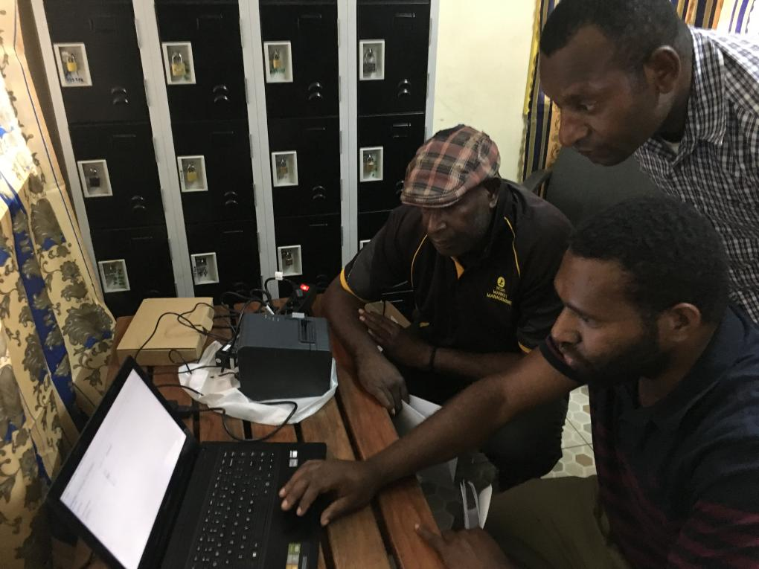
MARKET FEE
PAYMENT
SYSTEM
Notes:
This picture shows the NCDC market clerks and interns getting to know the new fee collection system.

Slide 7



Web-based ticketing system
NCDC
Report
Correct revenue is monitored
Data is stored in the cloud and can be accessed by NCDC remotely
Database, cloud
Each market has a local database that updates data to the server.
Market 1
Market 2
Market 3
Notes:
EXPLAIN DIAGRAM FIRST
The new fee collection system seeks to improve vendor safety and process efficiency.
There are two types of vendors: Regular vendors and seasonal vendors.
In the pilot, regular vendors could pay weekly at a reduced rate (K10 per week, rather than K2 per day).
Seasonal vendors continued to pay daily during the pilot period.
Regular vendors needed to register and sign a contract with NCDC @ the outset.
This is like renting a space (house/flat), with a lease.
The new system is a digital system.
It works offline.
When connected to the Internet, it can upload data.
This system was designed to improve safety at the market because cash from market fees would be centralised at the office, rather than kept by multiple market clerks standing around the market.
NB: $ from sales of vegetables/fruit etc. still circulates.
System aimed for improved transparency through automatic reporting of revenue to the City Hall, to reduce fraud and theft.

Slide 8
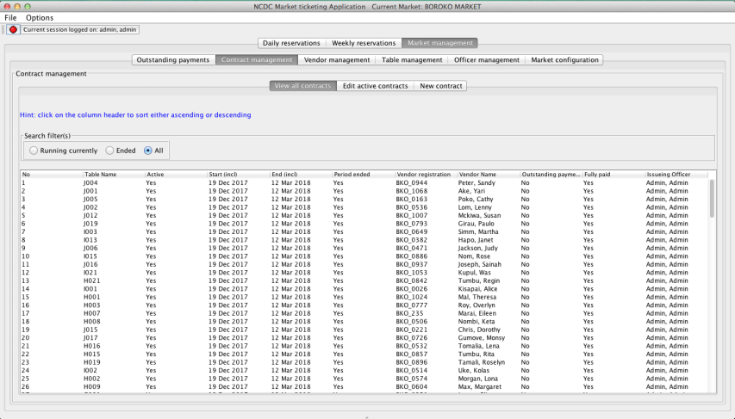
Part 1: ticketing system at the market
Ticketing System at the Market
Notes:
The first part of the software is installed at a market’s ticketing office.
This part of the system is the client software application.
It allows the market clerks to:
register vendors,
book a table for weekly or daily reservation,
make a contract, and
allocate tables to vendors.

Slide 9
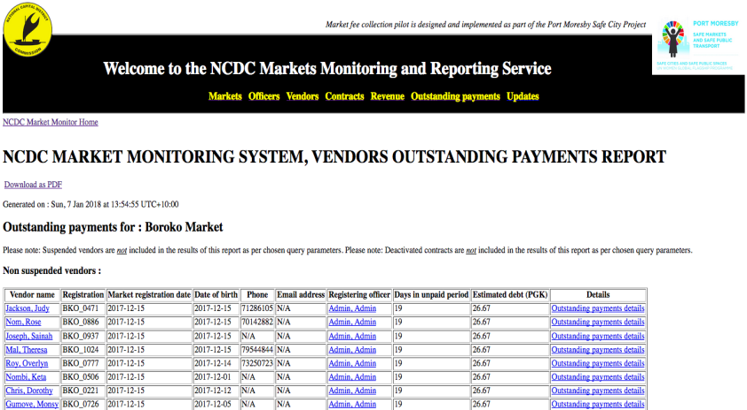
Part 2: ticketing system for monitoring
Market Monitoring
Notes:
The second part of the system, the NCDC cloud server application, is a monitoring system that incorporates a database holding all information regarding:
sold tickets,
changed or added contracts,
daily daybook bookkeeping,
added vendors etc.
for all the connected market places.

Slide 10
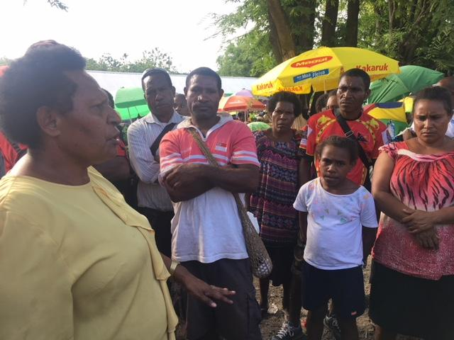
PILOT AT
BOROKO
MARKET
Notes:
Pic: NCDC Gender Desk Officer (who was Acting Markets Manager at the time of photo) sensitising vendors at Boroko Market on the upcoming pilot on the fee collection system.

Slide 11
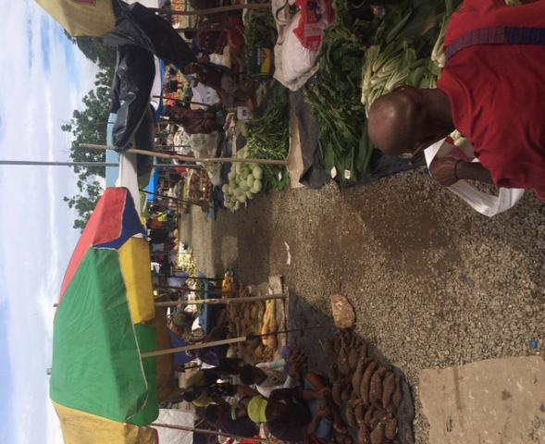
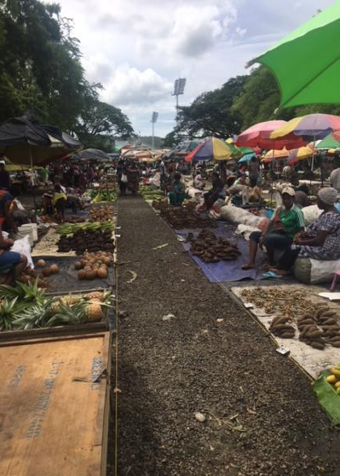
Pilot preparation 1: space marking
Pilot Preparation: Space Marking
Pilot Preparation 2
Before
After

Slide 12
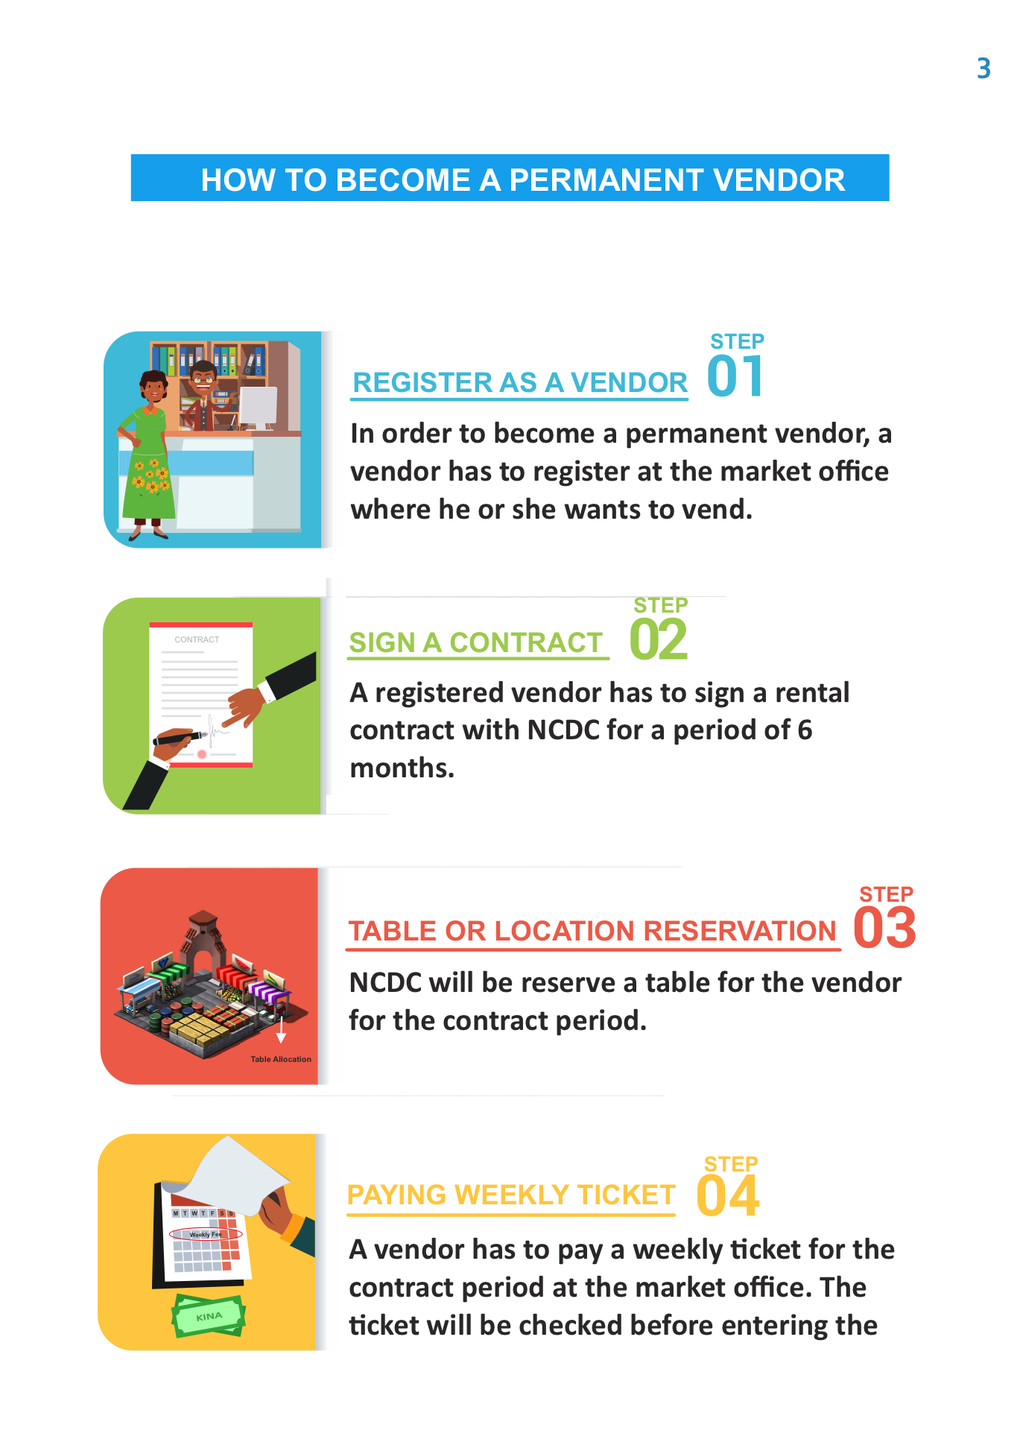
Pilot preparation 2: vendor booklet and contract

Slide 13
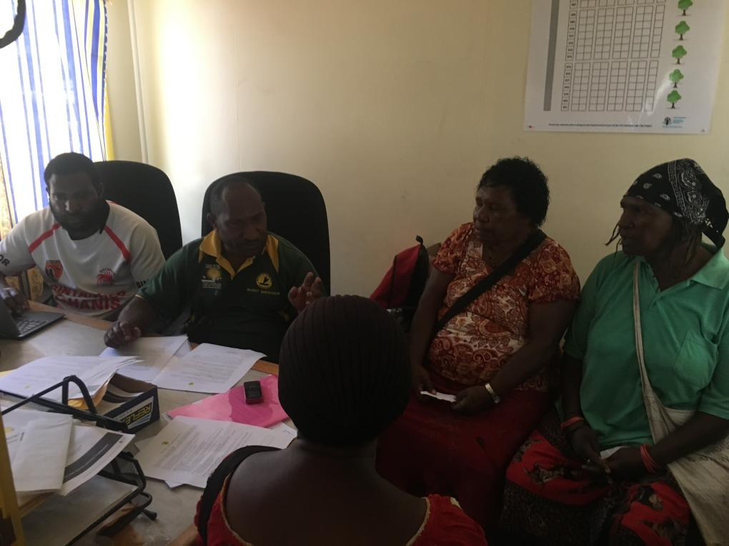
Pilot preparation 3: training
Ticketing officers (market clerks)
NCDC market management
Vendors
Notes:
Prior to the launch of the pilot at Boroko Market, training was conducted for all the users of the systems.
This included the ticketing officers who would collect the fees and update the computerised system at the markets.
NCDC Market Management was also trained to access the database to check payment status at markets, as well as to ensure cash submitted to the City Hall matched the amount reported online.
Vendors were also trained on the system and the requirements for signing up as a regular vendor.
Vendors were given the choice whether to take part in the pilot or not.
All the vendors who participated in the training chose to participate in the pilot as regular vendors.

Slide 14
Pilot at Boroko
Permanent vendors in pilot space
Duration: 12 weeks
Vendors registered: 142
Clerks operating the system: 4
Ticketing office open every day

Slide 15
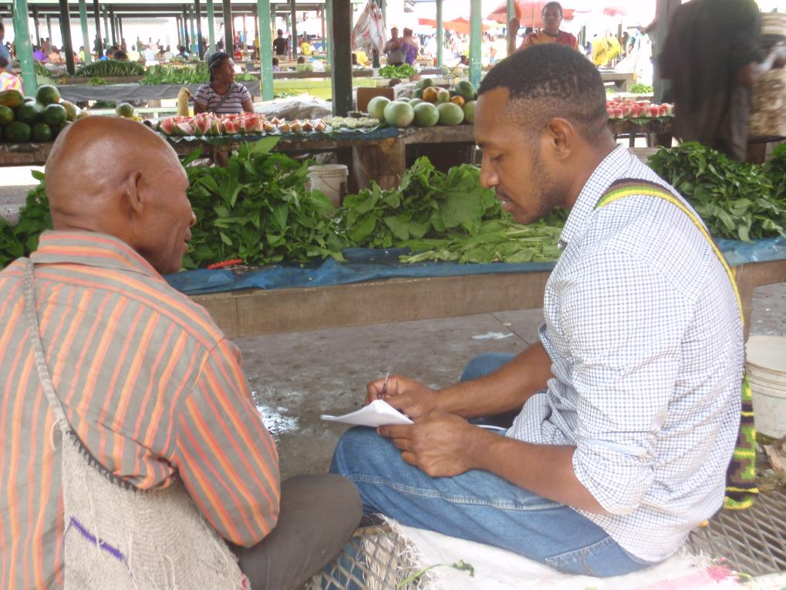
EVALUATION
Notes:
Following the 12-week pilot period, an evaluation of the system was conducted.

Slide 16
End results for the pilot
Pilot period: 12 weeks (14 December – 14 March 2018)
Around 60 % of the vendors paid in full.
Eviction notices served twice by NCDC Market Management, but no actual evictions carried out.
New vendors entered site, but not registered in the pilot.

Slide 17
Survey: respondents
Demographics of respondents (n=57):
  49 female, 8 male
  23 have a bank account, 34 have no bank account
  28 have a mobile phone, 28 have no mobile phone, 1 NA
  34 selling on own stall, 20 selling on someone else’s stall, 3 NA
  39 vendors sell 6 days/week, 8 sell 5 days/week, 5 sell <5 days/week, 5 NA
  NA = No Answer

Slide 18
Survey: vendor knowledge of rules
Vendor knowledge of rules
* Weekly cost: Correct = 46, Wrong = 4, Don't know = 3, 4 NA
* Payment location: Correct = 45, Wrong = 6, Don't know = 0 , 6 NA
* When to pay?: Correct = 36, Wrong = 4, Don’t know =10, 7 NA
* What to receive after payment?
  Correct = 42, Wrong = 4, Don't know = 4, 7 NA
  NA = No Answer

Slide 19
Survey: vendor evaluation of the system
Experience of the market fee collection system
  Contract signed? Yes = 38, No = 18, 1 NA
  Contract expired? Yes = 38, No = 18, 1 NA
  Vendor booklet received? Yes = 28, No = 26, 3 NA
  Briefing on system received? Yes = 30, No = 24, 3 NA
  Received a vendor ID? Yes = 22, No = 23, 12 NA
  What do you think about the weekly fee?
  Too much = 18, Too little = 0, Just right = 31, Don't know = 2, 6 NA
  Prefer weekly or daily payment?
  Weekly = 20, Daily =34, 3 NA
  NA = No Answer

Slide 20
Interviews: market clerks & NCDC Market Division
What is pleasing about the system?
  “From the project site (not the entire market), extortion had been reduced.” -Clerk 3
  “In comparison to the older system, it makes my job a lot more easier. Because I know the expected revenue, and can report to my boss and check the controllers” -NCDC management 1
What are the challenges encountered?
Outstanding payment
  “Weekly payment is good, however, vendors have challenges in settling outstanding payments” -Clerk 1
  “[I] think that NCDC has the right to take back space, but vendors have different background so NCDC cannot evict, as we (clerks) also risk our lives in the process” -Clerk 2
  Facility
  “Area A of the pilot system had no full time vendors from the beginning; due to heavy down falls, the flooded area did not also appeal to customer[s] to check out goods that way. So when NCDC did not make any good revenue from that area.” -Clerk 3
  “At the pilot sun, there are no proper sheds. Vendors are selling their produce exposed to sun, wind, and rain” -Clerk 3
Notes:
In summary, clerks & management said that the new system:
Reduces their work load including fee collection revenue and administration
Problems/issues identified:
Literacy level (clerks & vendors)
Leniency / safety
The need for support to use the digital system and manage the market

Slide 21
Evaluation results
Usage of spaces changes over time. Vendors ask others to mind their space, or empty spaces are occupied by casual vendors. There is a lack of space management and control by market clerks.
Vendors who come 6 days a week are in general satisfied with the system, as they appreciate the financial benefit of being registered as regular vendors.
Vendors expect adequate facilities at the market in compensation for their market fee payments.
A large amount of outstanding payments accrued during the 3-month-long trial. This shows a lack of dedicated human effort to monitor the system.
Notes:
Usage of spaces changes over time.
Vendors often have others minding their space, or empty spaces are occupied by casual vendors.
There is a lack of space management and control by the clerks.
Of those approached, only 49% of them had received the booklet and 52% of them had received a briefing on the system.
40% of the vendors are selling on spaces that are not registered as theirs.
As they are not registered/regular vendors, they prefer to pay daily fees.
Vendors who come 6 days a week are in general satisfied with the system, as they appreciate the financial benefit of being registered as regular vendors.
Vendors expect adequate facilities at the market in compensation for their market fee payments.
A large amount of outstanding payments accrued during the trial. This shows a lack of dedicated human effort to monitor the system.

Slide 22
Lessons learnt
The computerised system for market management and ticket sales is only of added value when human effort is made to ensure appropriate implementation.
What started as a payment system project has evolved into a bigger market management project, which shows the need for space management, improved market facilities, market middle level management, improved clerk capacity level and increased vendor financial literacy.
While management, clerks and vendors feel positively about the system in general, continued support is needed to change the way fees are collected and markets are managed.

Slide 23
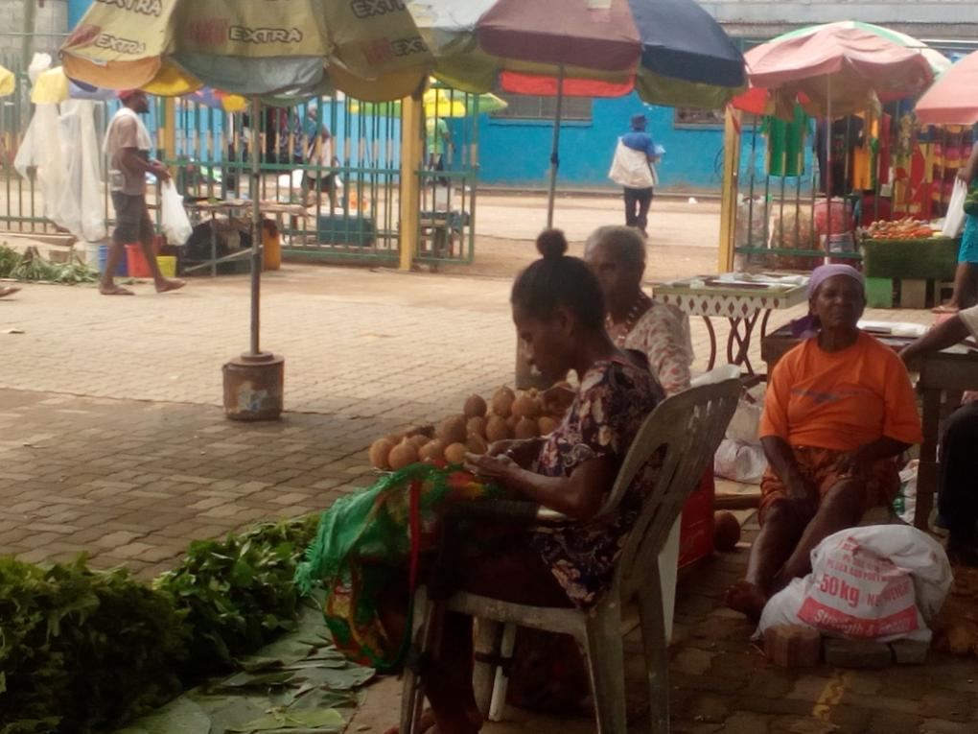
THANK YOU

