Slide 1
Health phone services in Papua New Guinea by Amanda H A Watson and Ralph Kaule

Slide 2
Dr Amanda H A Watson
ANU-UPNG Partnership
Lecturer, Australian National University
Visiting Lecturer, University of Papua New Guinea
www.ahawatson.com
amanda.watson@anu.edu.au
Twitter: @ahawatson

Slide 3
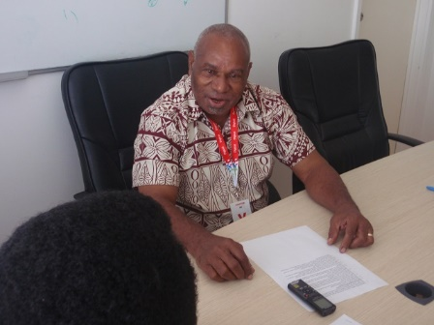
Mr Ralph Kaule
Lecturer, University of Papua New Guinea
rkaule@upng.ac.pg
Photo: Mr Ralph Kaule conducting a research interview in 2017 (source: Watson)

Slide 4
Telehealth
The term telemedicine is typically limited to phone consultations between medical practitioners and patients (Zieliński, Duplaga & Ingram, 2006). Telehealth is a broad term incorporating “telemedicine and a variety of nonphysician services, including telenursing” (Weinstein et al., 2014, p. 183).

Slide 5
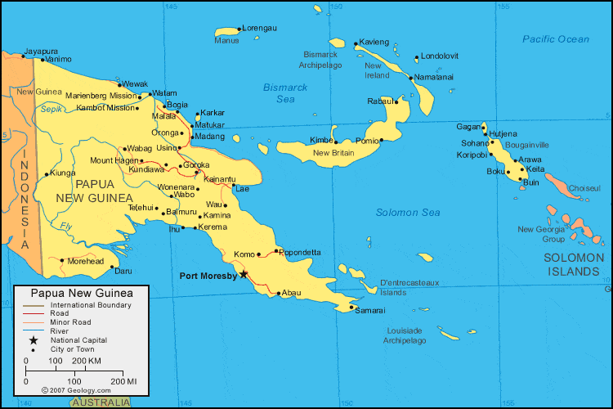
Papua New Guinea
Figure: Map of Papua New Guinea (source: geology.com)

Slide 6
Telehealth
Interviews conducted | Number
Port Moresby | 11
Provincial town | 11
Rural health facility | 2
Total | 24

Slide 7
Telehealth
Interviewee sex | Number
Male | 13
Female | 11
Total | 24

Slide 8
Telehealth
Interviewee work experience | Number
Public health professional | 6
Telecommunication company employee | 5
Rural health worker | 4
Health administrator | 4
Doctor | 2
Nurse | 2
Trained counsellor | 1
Total | 24

Slide 9
Telehealth
Interviewee telehealth experience | Number
Currently works, or has worked, managing a telehealth service | 18
Has not used a telehealth service | 3
Currently works, or has worked, answering calls | 2
Experience as a client of a telehealth service (e.g. rural health worker) | 1
Total | 24

Slide 10
Telehealth
Sustainability is a key factor regarding innovations financed by aid.
In PNG, some aid-funded telehealth projects have been sustainable and are ongoing, whilst others have not been sustainable and have ceased to operate.

Slide 11
Telehealth
What factors lead to failure and/or success of a telehealth service in PNG?

Slide 12
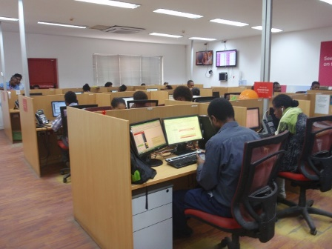
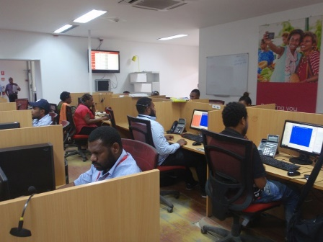
Telehealth
A key lesson learnt is that phone services which are open to the public are expensive, requiring long-term investment and strategic, sustained promotional activities.
Photos: Digicel call centre, Port Moresby (source: Watson 2017)

Slide 13
Telehealth
“There has to be consistent flow of funding, especially for this, this program that there is continuation of service. […] If programmes like call centre has to come in, there has to be sufficient budget for it …. to, you know, maintain its, ahh, maintain the services, and that’s vital.”
Source: Research interview

Slide 14
Telehealth
“All the rural villagers […], they must understand why the call centre exists. If they know the reason for it, I think they will, you know, [ring]. So we have to have, ahh, people, ahh, …. have a lot of awareness in the villages, [about] why the call centre is existing, [and] the functions of the call centre, [so that] they can understand this.”
Source: Research interview
Translated from the following interview quote in both Tok Pisin and English: “Ol lain long ples […], olsem ol i mas understandim why call centre em i exist. Sapos ol i save long reason bilong dispela, me ting olsem olgeta bai wanemia, so we have to have, ahh, people, ahh, …. have a lot of awareness in the villages, why the call centre is existing, the functions of call centre. Ol ken understandim dispela.”

Slide 15
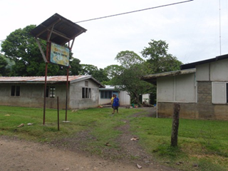
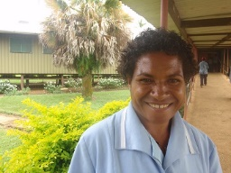
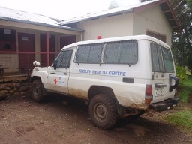
Telehealth
Another key lesson is that phone services which are accessible only to health workers are less costly and can be beneficial in terms of improving health system efficacy and efficiency.
Photo: rural health facility, Milne
Bay Province (source: Watson)
Photo: rural health worker, Western
Highlands Province (source: Watson)
Photo: ambulance, Western
Highlands Province (source: Watson)

Slide 16
Telehealth
“For the health workers, they get plenty of help through this. Like some, they didn’t know how to deliver the baby, mostly it was like maternal, child, ahh, childbirth, and they need help, and they ring. We ring ONG doctors, same hour, same time, they give advice, so then we ring go back […] that’s the help they get straight away, so it’s just like we are talking face-to-face.”
Source: Research interview
Translated from the following interview quote in both Tok Pisin and English: “Long sait bilong health worker tu em olsem ol i kisim planti helpim long dispela. Like some they didn’t know how to deliver the baby, mostly it was like maternal child ahh, olsem long karim pikinini na ol i nidim helpim na ol sa ring kam, em ol ONG doctors mipla ring, same hour same time ol sa givim advice, so then mipla sa ring go bek […] em helpim em ol kisim straight away so it’s just like we are talking face-to-face.”

Slide 17
Telehealth
“There are some instances where our staff lives were in, uhh, under threat …. and …. just a phone call and it …. uhh, we, we save them from the threat, you see, amm…. previously we receive message, without a phone call, we receive message later that …. ohh the vehicle has been stolen, the staff were beaten up, all these.”
Source: Research interview

Slide 18
Telehealth
“[It’s a] very effective way of referring patients and talking with and readying the health workers. We have phone numbers for all the health centres so we can ring and they can be ready. Because we were given all the numbers for ringing them, so we can ring and say ‘oh, a patient is coming, you […] wait for them’. […] So it’s effective assistance.”
Source: Research interview
Translated from the following interview quote in both Tok Pisin and English: “Very effective way of referring patients na toktok wantaim narapela wokman mipela redim em long hapsait. Like mipela gat olgeta fon namba bilong olgeta health centre i stap so mipela sa ring na ol sa expectim na stap. Because ol givim mipela ol namba long ringim ol lain tu so mipela ring na tok ‘oh patient kam lo dispela, yu […] wetim em’. […] So em bin helpim effectively.”

Slide 19
Telehealth
In conclusion, strategic use of phones between health workers has demonstrable benefits.

Slide 20
Health phone services in Papua New Guinea by Amanda H A Watson and Ralph Kaule
www.ahawatson.com
amanda.watson@anu.edu.au
Twitter: @ahawatson
rkaule@upng.ac.pg
NB: This research was also presented at the Australasian Aid conference, February 2018, Australian National University, Canberra.

