Slide 1
Why is PNG’s government resource revenue so low?
Stephen Howes
Development Policy Centre ANU

Slide 2
Structure
What is (government) resource revenue and why does it matter?
What is the evidence that it is low?
Possible theories for why it is low
Project-wise evidence and analysis: PNG LNG, Ok Tedi, and Lihir
Conclusions

Slide 3
What is resource revenue?
The payment of resource (mineral and petroleum) sale proceeds to government.
  Corporate tax
  Dividends
  Production sharing agreements
  Royalties (if to government)
The means by which governments try to capture the “rents” of resource projects.
  The way in which the population benefits from the extraction of their resources.
For simplicity, mainly focus on corporate taxes in this presentation.

Slide 4
Low compared to what?
History
Size of the resource sector
Other countries

Slide 5
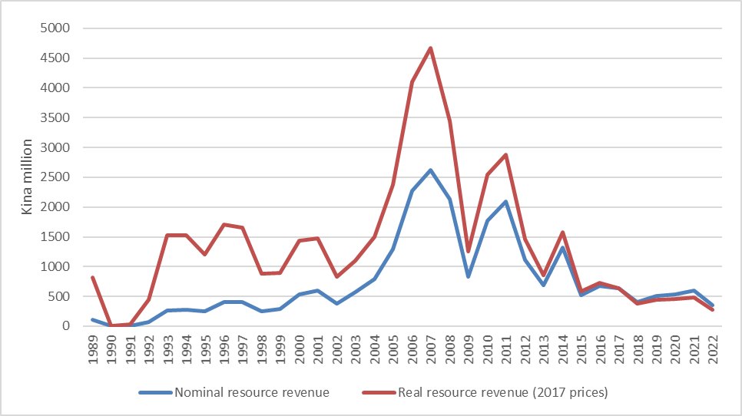
Compared to history
Source: PNG Budget Database

Slide 6
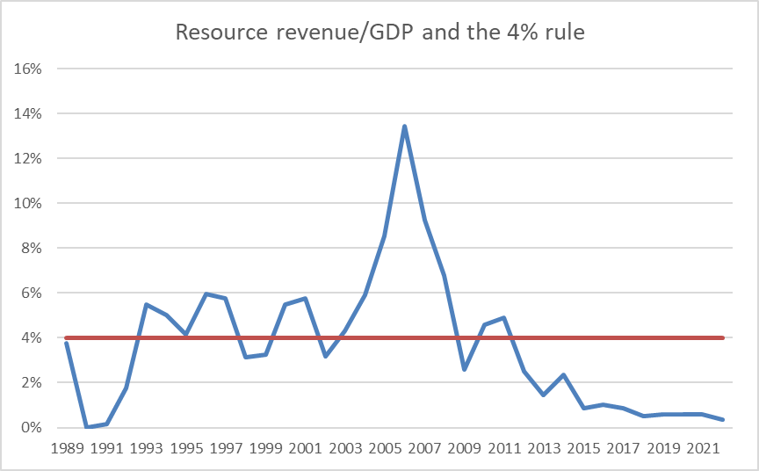
Whatever happened to the old 4% rule?

Slide 7
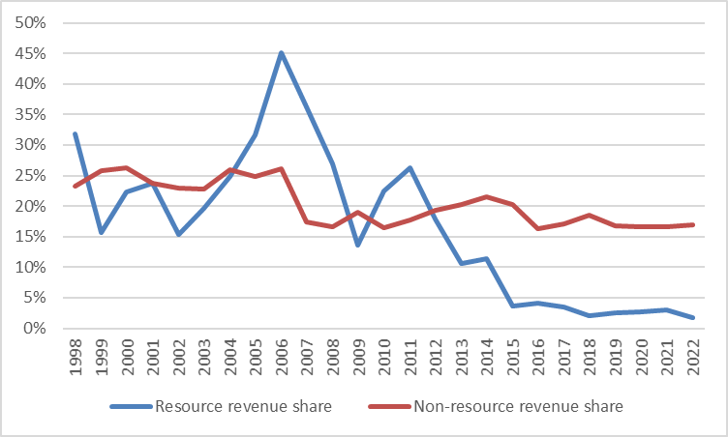
Compared to the size of the resource sector
Source: PNG Budget Database

Slide 8
Compared to other countries
PNG
PNG
Source: “Resource dependence and fiscal effort in Sub-Saharan Africa” by Alun Thomas and Juan P. Trevino, IMF Working Paper, WP/13/88. 2013.

Slide 9
What is going on?
Low prices?
New projects?
The taxation regime?
Bad luck?

Slide 10
Low prices?
Source: PNG 2018 Budget, Vol. 1

Slide 11
But now recovering
Copper
Oil
Gold
Source: PNG 2018 Budget, Vol. 1

Slide 12
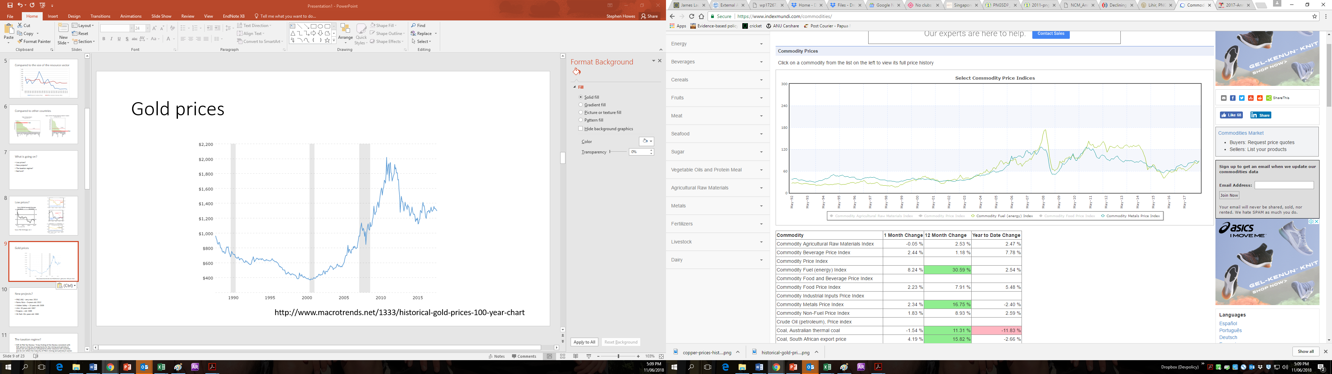
Commodity prices currently look more like the 00s than the 90s
https://www.indexmundi.com/commodities/

Slide 13
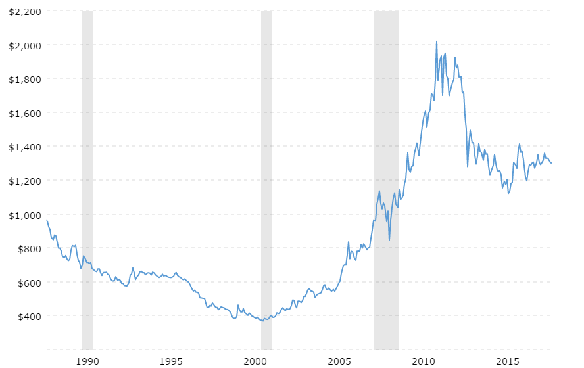
Gold price over the long term
http://www.macrotrends.net/1333/historical-gold-prices-100-year-chart

Slide 14
New projects?
PNG LNG - very new: 2014
Ramu Nico – 5+years old: 2012
Hidden Valley – 10 years old: 2009
Lihir: 20 years old: 1997
Highlands oil: 1992
Porgera – Almost 30 years old: 1989
Ok Tedi: 30+ years old: 1984

Slide 15
A generous taxation regime?
E.g. Ramu Nico 10 year tax holiday.
IMF & PNG Tax Review: “A key finding of the Review consistent with IMF advice is that tax arrangements for the mining and petroleum sector are very generous compared to other resource rich countries and do not reflect the maturity of PNG’s mining and petroleum sector. This is due to project specific arrangements and general tax incentives that have eroded potential government revenue.” (Tax Review p. 90)
But PNG Tax Review Issues paper on mining rates: “These rates also compare with the average rates found in other mining jurisdictions. Although they are concessionary rates with regard to the general taxation provisions for PNG, the rates for company income tax and dividend withholding tax are, apart from the level of royalties, broadly in line with those of other mining countries.”

Slide 16
Project-by-project analysis
PNG LNG
Lihir
Ok Tedi
Note: analysis entirely based on information in the public domain.

Slide 17
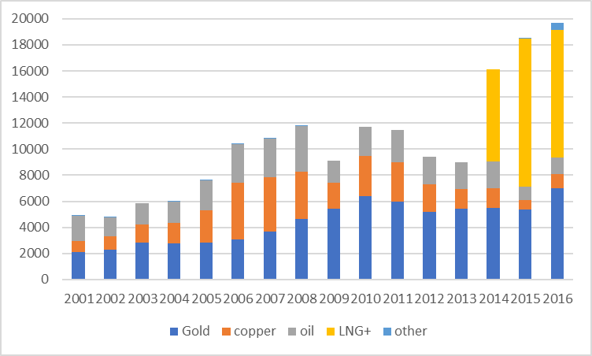
The importance of PNG LNG
Source: BPNG

Slide 18
The importance of Lihir and Ok Tedi
Source: EITI 2016

Slide 19
Corporate tax paid by PNG LNG, Lihir, Ok Tedi
Sources and notes: PNG EITI reports for Lihir and PNG LNG; Ok Tedi Annual Reviews for Ok Tedi; PNG LNG corporate tax estimated from Santos tax payments, divided by its share in the project. Lihir and PNG LNG corporate tax payments are reported paid; Ok Tedi reported accrued.

Slide 20
PNG LNG
Revenue of $4.1 billion in 2015 (from BPNG) in line with the Acil Tasman (AT) high case and $3.1 billion in 2016 the study or base case.
  Prices lower but output higher.
Yet AT predicted company tax of over K1.5 billion in the study case, much more in the high case. Why K0.1 billion in 2015 and nothing in 2016?
Capital cost blow outs from $10 to $19 billion.
Operating costs may also be above the $200 million in the AT.
This is enough to reduce corporate tax to zero in the base case, and to a small amount even in the high case – but still above K500 m not the K130 calculated to EITI.
Note considerable uncertainty about both tax paid and why tax paid.

Slide 21
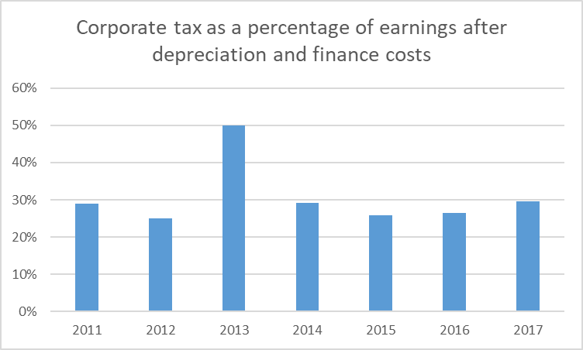
Ok Tedi: Corporate tax a relatively fixed percentage of profits

Slide 22
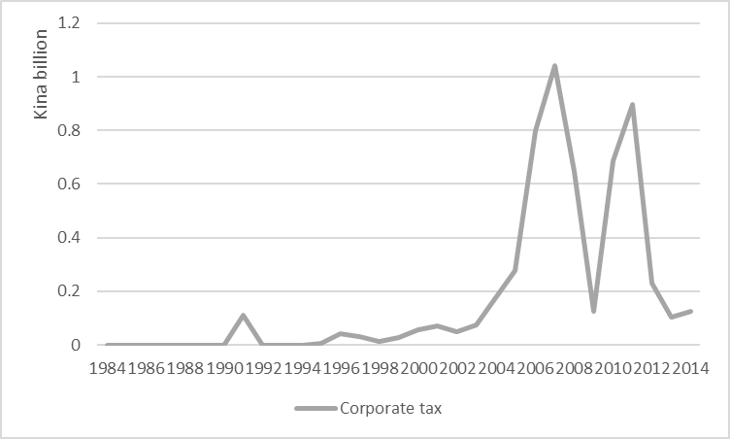
But corporate taxes a fraction of their boom high
Source: OK Tedi Mining Limited 2016 Historical Statistics

Slide 23
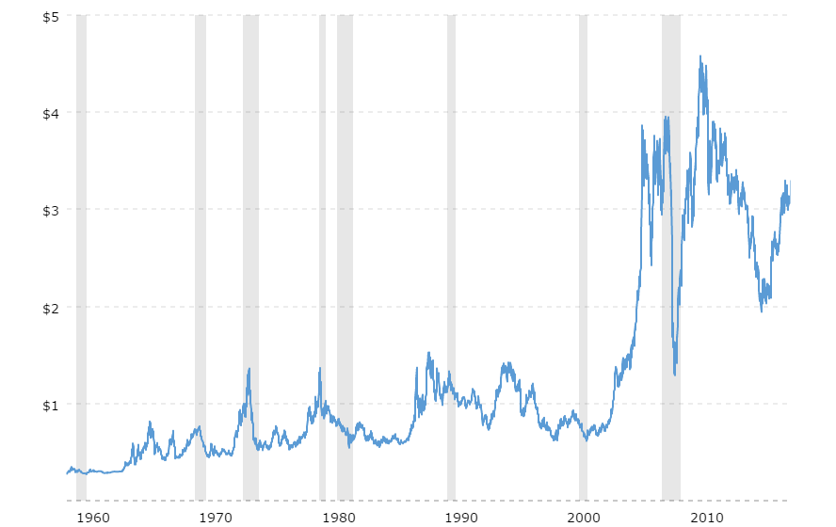
Copper prices once again very high
http://www.macrotrends.net/1476/copper-prices-historical-chart-data

Slide 24
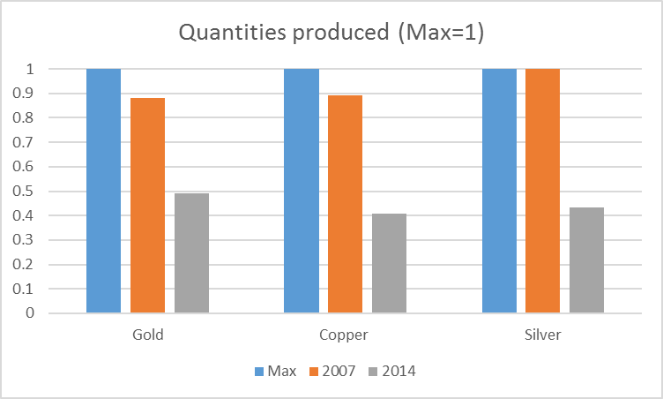
But the mine is producing much less now than at its peak (unlike the 2000s boom)
Source: OK Tedi Mining Limited 2016 Historical Statistics

Slide 25
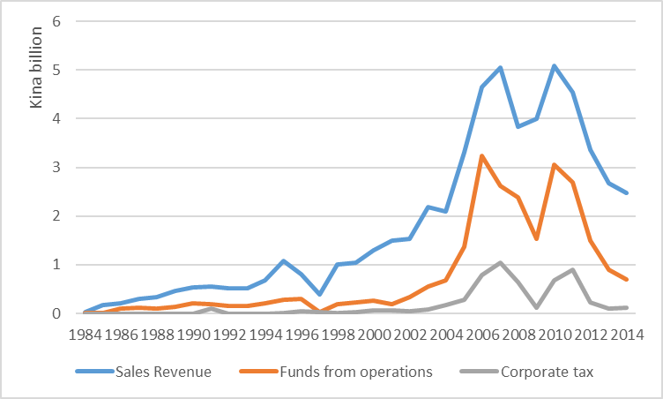
Now the mine is much less productive.
Source: OK Tedi Mining Limited 2016 Historical Statistics

Slide 26
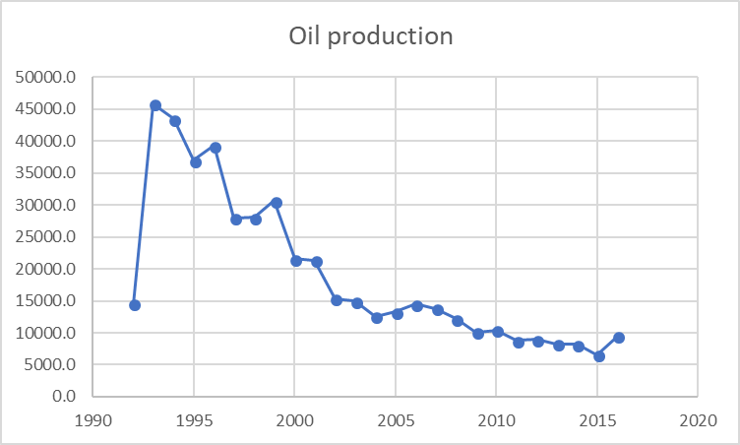
Similar story with oil, tho timing not as coincidental: volumes peaked in the 1990s

Slide 27
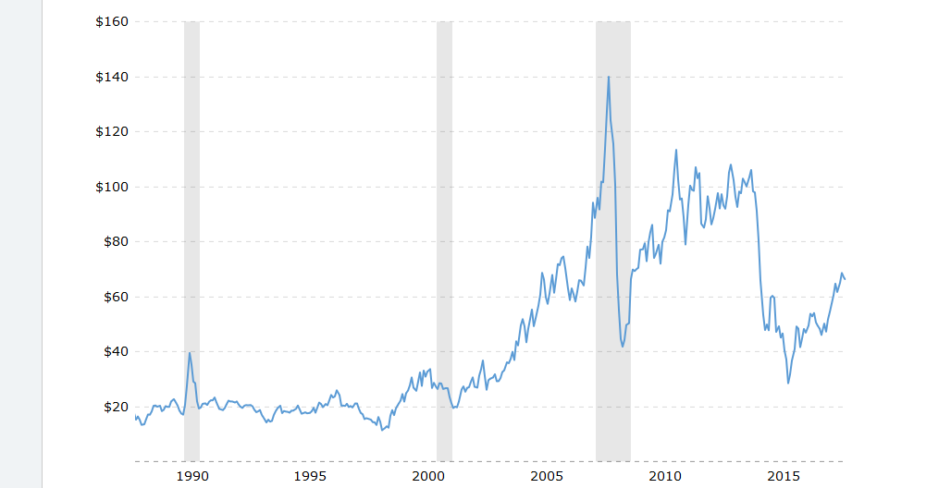
Prices peaked in the 2000s

Slide 28
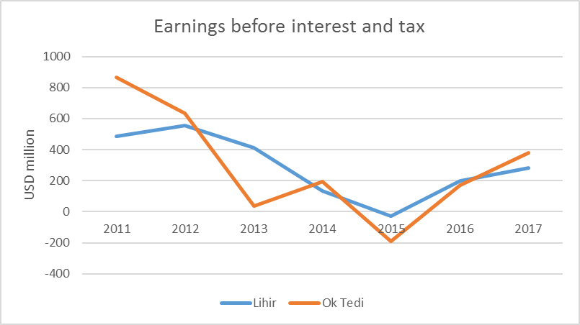
Lihir: very similar earnings to Ok Tedi
Source: Lihir and Ok Tedi Annual Reports

Slide 29
Yet Lihir pays no corporate tax. Why?
  2016 PNG EITI report: high capital expenditures. But this is captured in the deprecation.
  Interest payments to parent company?
  Asset impairment?
  Tax credits?
  Certainty about tax paid but complete uncertainty as to why.

Slide 30
Summary of case studies

Slide 31
So, why is PNG’s government resource revenue so low?

Slide 32
Conclusions (I): bad luck
Low revenue partly a timing issue (bad luck)
  Ok Tedi regularly pays taxes out of earnings, but it is a lot less profitable than it used to be.
  Oil projects also depleting.
  On reason PNG LNG not paying tax due to it being a new, capital-expensive project
This itself is an important conclusion, as it shows that to get a lot from resource projects you don’t just need high prices, but high prices at the right time.
The volatility and luck involved demonstrates the importance of putting in place a SWF.

Slide 33
Conclusion (II): transparency and EITI
There is also a lot we can’t explain
  PNG LNG’s very low corporate taxes in 2015.
  Lihir’s zero corporate taxes
EITI useful but only takes us so far.
  EITI should give tax by project as well as company
    GloCo (PNG LNG Global Company LLC) missing in EITI?.
  EITI will only tell us about corruption; it won’t explain why tax revenue is low.
We need more corporate data
    Ok Tedi provides almost complete financial information.
    Lihir provides some financial information
    PNG LNG provides no financial information.
Either more corporate transparency; or government could take the lead.

Slide 34
Conclusion (III): future research and future resource projects
This issue requires a lot more research.
These issues should be resolved prior to no resource agreements being agreed to.

Slide 35
Thank you!

Slide 36
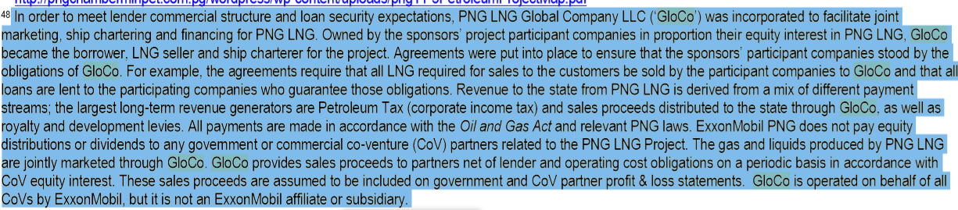
GloCo (EITI 2016 national report)

Slide 37
Note on other risks to resource revenue
Increased revenue sharing with provincial governments and landowners.
Income Tax Credit

